Slide 1


Beauty Salon Database
Presented By:
Joseph Attieh
Mia Antoun
Clara Akiki

Slide 2
Outline
Objective and Tools
Overview
Reasons for choosing this topic
Process of thinking
Difficulties
Conclusion
Demo

Slide 3
Objective and Tools
Get a hands on experience on how to create a database from scratch
With the help of mySQL in order to manage the database
With the help of java (javafx) and css in order to create GUIs

Slide 4
Outline
Objective and Tools
Overview
Reasons for choosing this topic
Process of thinking
Difficulties
Conclusion
Demo

Slide 5
Overview
This project aims to develop a graphical interface for a Beauty Salon
The goal is to provide effective tools for storing and manipulating information useful in a Beauty Salon

Slide 6
Outline
Objective and Tools
Overview
Reasons for choosing this topic
Process of thinking
Difficulties
Conclusion
Demo

Slide 7
Reasons for choosing this topic
The database can be used in any beauty salon
Mia’s mother wants to open a beauty salon in the near future
Perfect opportunity to help!

Slide 8
Outline
Objective and Tools
Overview
Reasons for choosing this topic
Process of thinking
Difficulties
Conclusion
Demo

Slide 9
Process of thinking
Identify the essential entities: Staff, Customer, Appointment, Service, Product, Supplier, Order
Identify the relations connecting these entities
Identify useful attributes for these entities
Build the CDM (conceptual data model)

Slide 10
Process of thinking
Build, from the CDM, the LDM(logical data model) which is the main reference when creating the database
Implement the database in mySQL
Connect the database to java (mySQL connector)

Slide 11
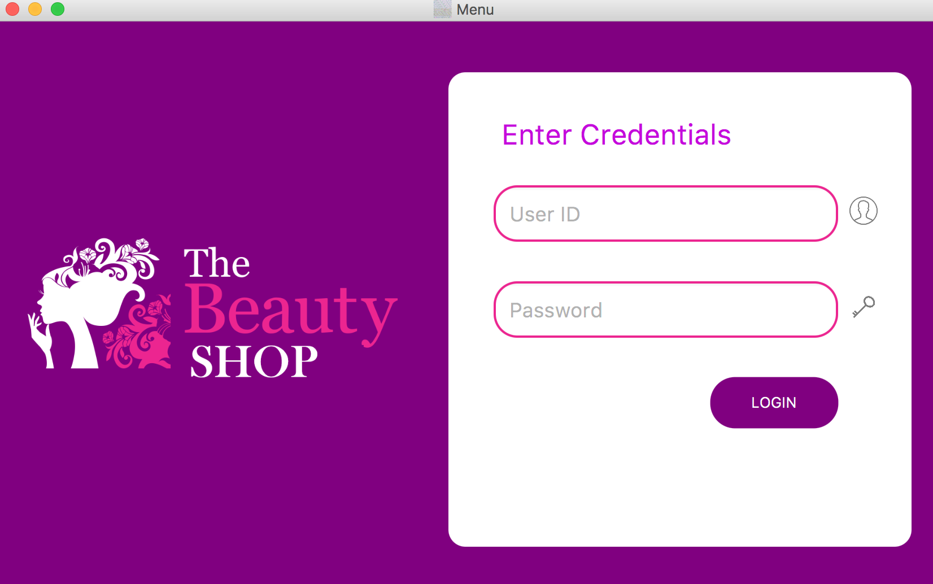
Process of thinking
Think about the user interface
(staff has to enter his login credentials in order to manipulate the database)

Slide 12
Process of thinking
Recognize the main functionalities: searching, adding, editing, deleting data
Implement these simple queries first in mySQL and then create its associated interface in javafx that allows the non-expert user to interact with the database
Select the useful complex queries and implement them in mySQl first and in javafx second

Slide 13
Outline
Objective and Tools
Overview
Reasons for choosing this topic
Process of thinking
Difficulties
Conclusion
Demo

Slide 14
Difficulties
Main difficulties encountered were with building the interface using javafx
Since the theoretical part (building the tables) was covered throughout the course

Slide 15
Difficulties
Populate the data of the database in the graphical interface
Update the combo box

Slide 16
Difficulties
All the problems we encountered could be solved easily with time and perseverance!

Slide 17
Outline
Objective and Tools
Overview
Reasons for choosing this topic
Process of thinking
Difficulties
Conclusion
Demo

Slide 18

Conclusion
Implemented all the helpful features for a Beauty Salon database
Interacted with the user using a graphical interface that is friendly and simple

Slide 19

Thank you !

Slide 20

Demo
Let’s check out the interface and explain the code!

